Slide 1

6th Grade Accelerated Math
Unit 1, Lesson 1 Finding the Greatest Common Factor Volume 1, pg. 3

Slide 2


Benchmark
MA.6.NSO.3.1
Given a mathematical or real-world context, find the greatest common factor and least common multiple of two whole numbers.
volume 1, pg. 3

Slide 3
Integrated Mathematical Thinking and Reasoning Standards
MA.K12.MTR.5.1 Use patterns and structure to help understand and connect mathematical concepts.
MA.K12.MTR.7.1 Apply mathematics to real-world contexts.
volume 1, pg. 3

Slide 4

Learning Targets
I can find the greatest common factor (GCF) in mathematical and real-world contexts.
I can rewrite fractions in simplest form using the greatest common factor (GCF) of the numerator and denominator.
volume 1, pg. 3

Slide 5

Warm-Up
volume 1, pg. 3

Slide 6

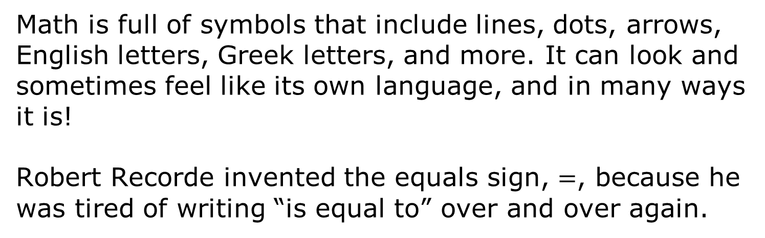
1.1.1 Warm-Up: Where Do Math Symbols Come From?
Math is full of symbols that include lines, dots, arrows, English letters, Greek letters, and more. It can look and sometimes feel like its own language, and in many ways it is!
Robert Recorde invented the equals sign, $=$, because he was tired of writing “is equal to” over and over again.
volume 1, pg. 3

Slide 7
What is a word or phrase that you use a symbol to represent instead of writing it out each time?
Why did early mathematicians decide to use symbols to express operations, phrases, and mathematical ideas?
Why are math symbols still helpful to us today?
volume 1, pg. 3

Slide 8

Guided Instruction
volume 1, pg. 4

Slide 9
1.1.2 Guided Instruction: Greatest Common Factor
Marcus and Tonya are making care packages for soldiers overseas. Inside of each package, they will include popular snacks and handwritten letters. They have 16 snacks and 12 letters to put in the care packages. They want each care package to be equally sized, containing both snacks and letters, with nothing left over.
volume 1, pg. 4

Slide 10
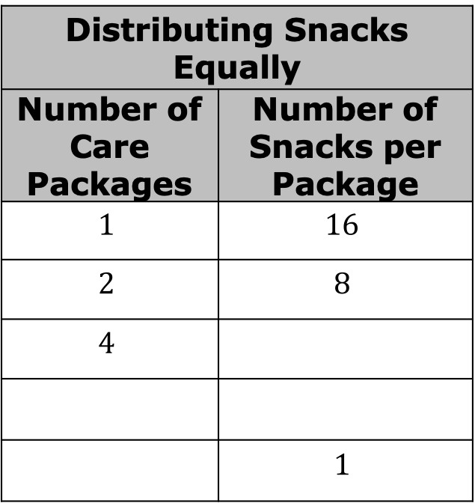
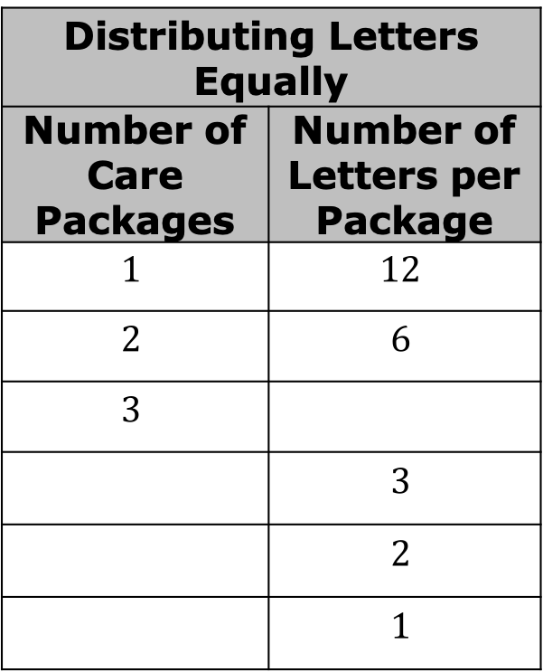
Complete the tables below to show the possible combinations when making each care package.
Distributing Snacks Equally
Number of Care Packages | Number of Snacks per Package
$$1$$ | $$16$$
$$2$$ | $$8$$
$$4$$
 | $$1$$
Distributing Letters Equally
Number of Care Packages | Number of Letters per Package
$$1$$ | $$12$$
$$2$$ | $$6$$
$$3$$
 | $$3$$
 | $$2$$
 | $$1$$
volume 1, pg. 4

Slide 11
What is the greatest number of care packages that can be created using only snacks?
What is the greatest number of care packages that can be created using only letters?
What is the greatest number of care packages that can be created using both snacks and letters?
volume 1, pg. 4

Slide 12


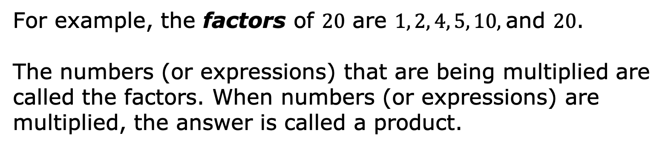

A factor is a number that divides into another number exactly and without leaving a remainder.
For example, the factors of $20$ are $1, 2, 4, 5, 10$, and $20$.
The numbers (or expressions) that are being multiplied are called the factors. When numbers (or expressions) are multiplied, the answer is called a product.
factor $×$ factor $=$ product
volume 1, pg. 4

Slide 13

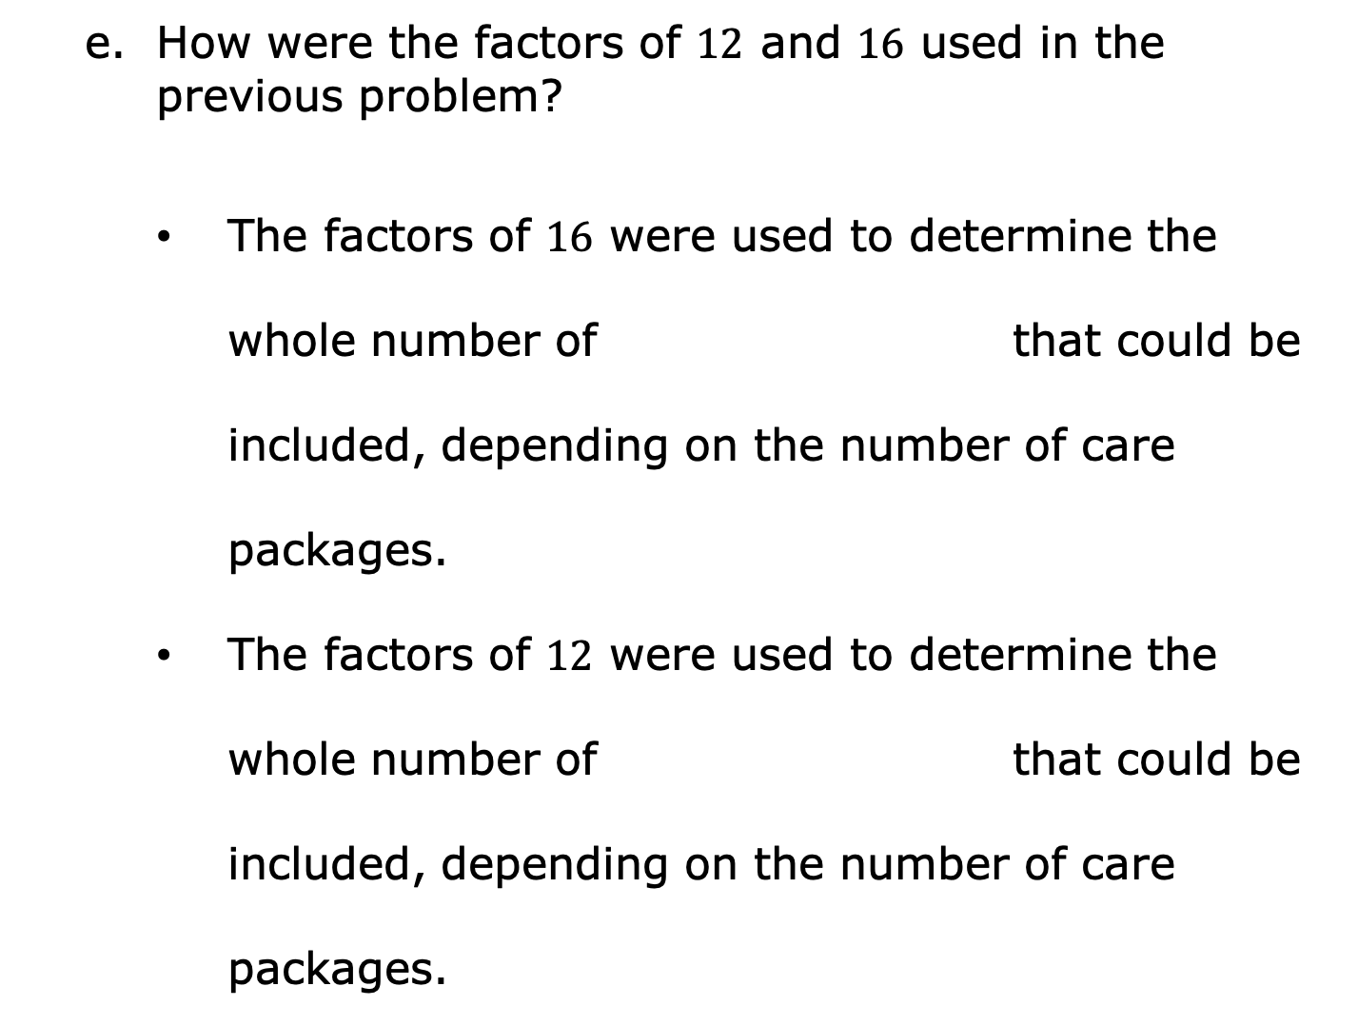
How were the factors of $12$ and $16$ used in the previous problem?
The factors of $16$ were used to determine the whole number of that could be included, depending on the number of care packages.
The factors of $12$ were used to determine the whole number of that could be included, depending on the number of care packages.
volume 1, pg. 5

Slide 14

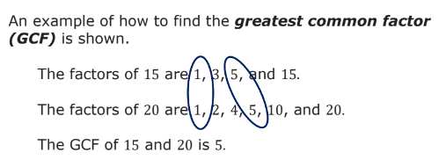
The greatest common factor, or GCF, is the largest common factor of two or more numbers.
An example of how to find the greatest common factor (GCF) is shown.
volume 1, pg. 5

Slide 15
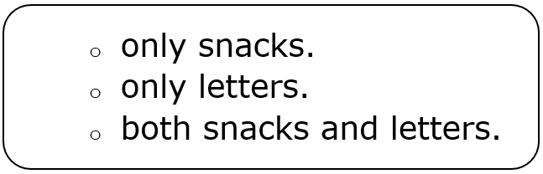
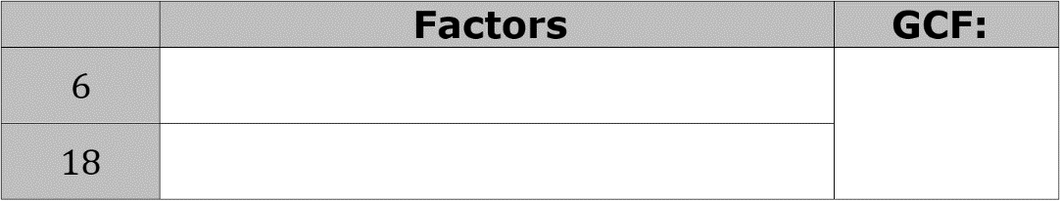
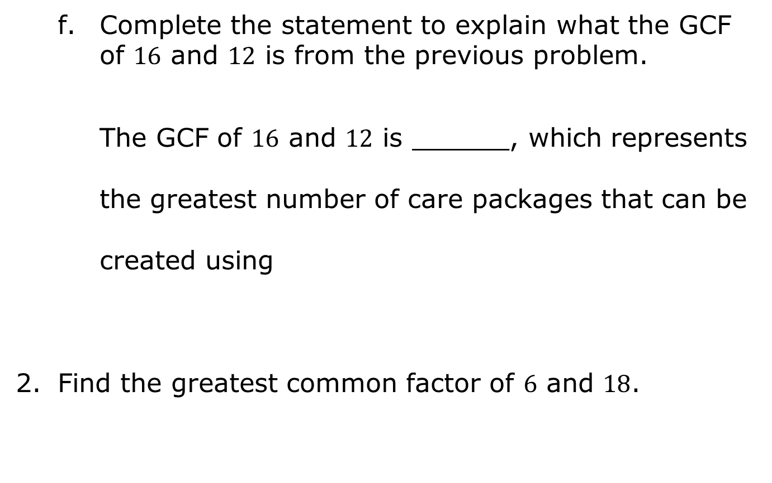
Complete the statement to explain what the GCF of $16$ and $12$ is from the previous problem.
The GCF of $16$ and $12$ is ______, which represents the greatest number of care packages that can be created using
Find the greatest common factor of $6$ and $18$.
volume 1, pg. 5

Slide 16

Try It
volume 1, pg. 6

Slide 17

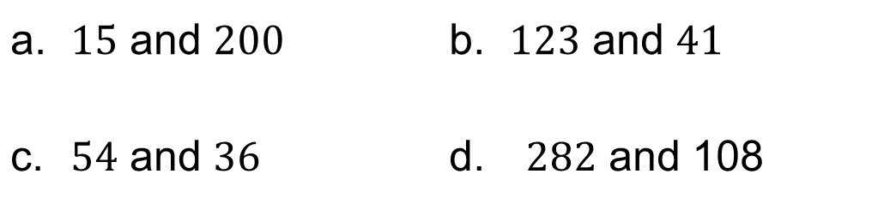
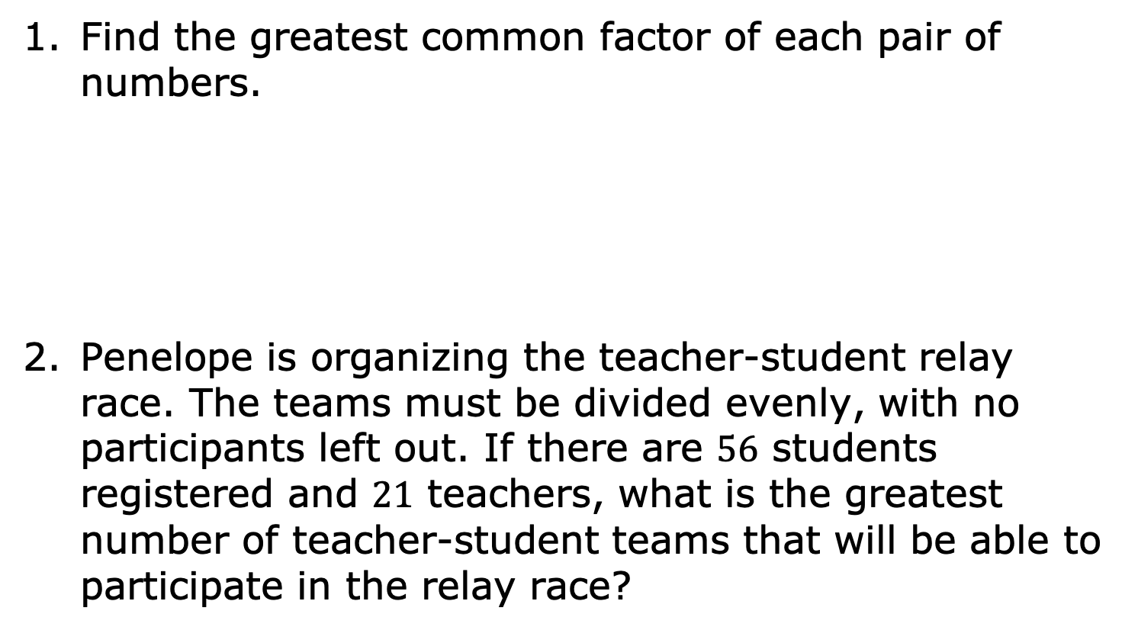
1.1.3 Try It: Greatest Common Factor
Find the greatest common factor of each pair of numbers.
Penelope is organizing the teacher-student relay race. The teams must be divided evenly, with no participants left out. If there are $56$ students registered and $21$ teachers, what is the greatest number of teacher-student teams that will be able to participate in the relay race?
$15$ and $200$ | $123$ and $41$
$54$ and $36$ | $282$ and 108
volume 1, pg. 6

Slide 18
Guided Instruction
volume 1, pg. 6

Slide 19

1.1.4 Guided Instruction: Writing Equivalent Fractions Using GCF
The GCF can also be used to rewrite fractions. When using the GCF to write an equivalent fraction, the result is often said to be in “simplest” form.
In the fraction $\frac{25}{90}$, the numerator is $25$ and the denominator is $90$.
What is the greatest common factor of $25$ and $90$?
To simplify a fraction, generate an equivalent fraction by dividing the numerator and denominator by the GCF of the numerator and denominator.
volume 1, pg. 6

Slide 20


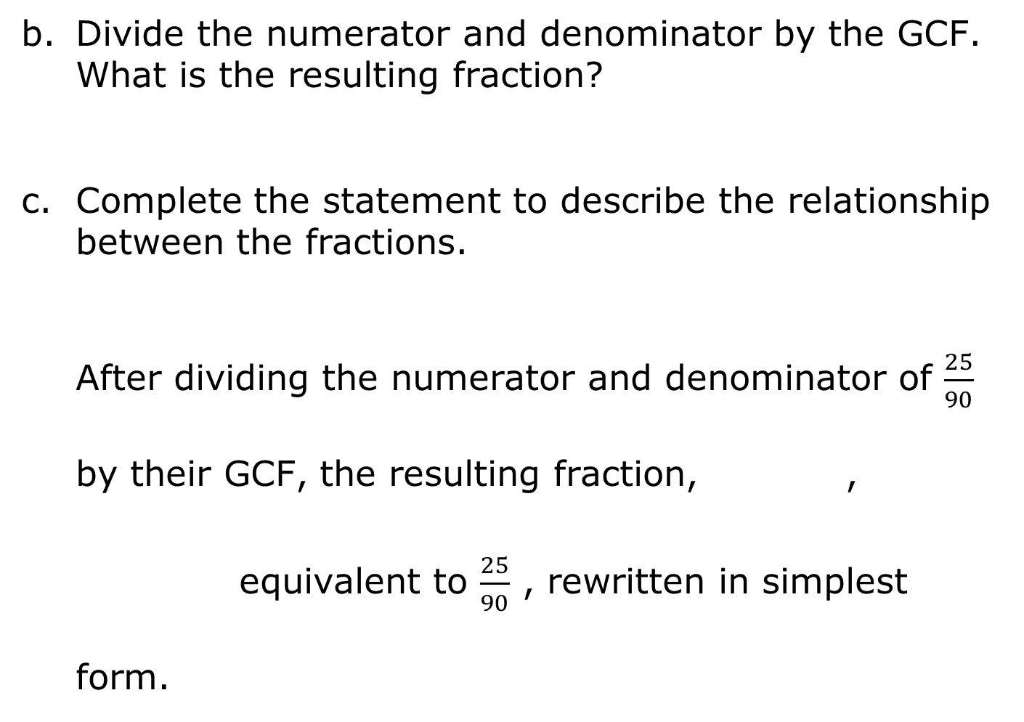
Divide the numerator and denominator by the GCF. What is the resulting fraction?
Complete the statement to describe the relationship between the fractions.
After dividing the numerator and denominator of $\frac{25}{90}$ by their GCF, the resulting fraction, , equivalent to $\frac{25}{90}$ , rewritten in simplest form.
volume 1, pg. 6

Slide 21
Try It
volume 1, pg. 7

Slide 22
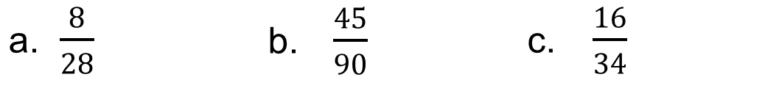
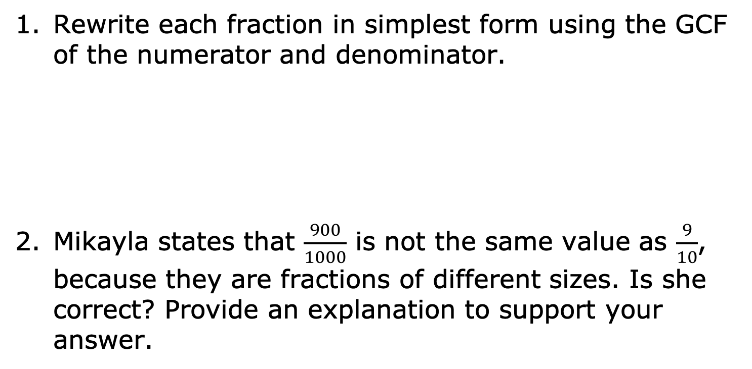
1.1.5 Try It: Writing Equivalent Fractions Using GCF
Rewrite each fraction in simplest form using the GCF of the numerator and denominator.
Mikayla states that $\frac{900}{1000}$ is not the same value as $\frac{9}{10}$, because they are fractions of different sizes. Is she correct? Provide an explanation to support your answer.
$\frac{8}{28}$ | $\frac{45}{90}$ | $\frac{16}{34}$
volume 1, pg. 7

Slide 23

Your Turn
volume 1, pg. 8

Slide 24

1.1.6 Your Turn!
Find the greatest common factor (GCF) of each pair of numbers.
Rewrite each fraction in simplest form using the GCF of the numerator and denominator.
$18$and $24$ | $45$ and $60$ | $665$ and $30$
$\frac{29}{87}$ | $\frac{10}{15}$ | $\frac{175}{210}$
volume 1, pg. 8

Slide 25
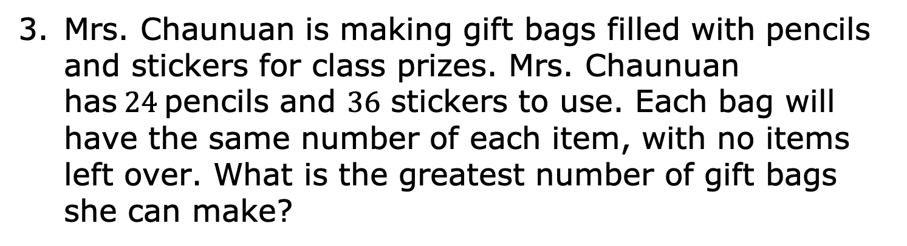
Mrs. Chaunuan is making gift bags filled with pencils and stickers for class prizes. Mrs. Chaunuan has$24$pencils and $36$ stickers to use. Each bag will have the same number of each item, with no items left over. What is the greatest number of gift bags she can make?
volume 1, pg. 8

Slide 26

Wrap-Up
volume 1, pg. 8

Slide 27
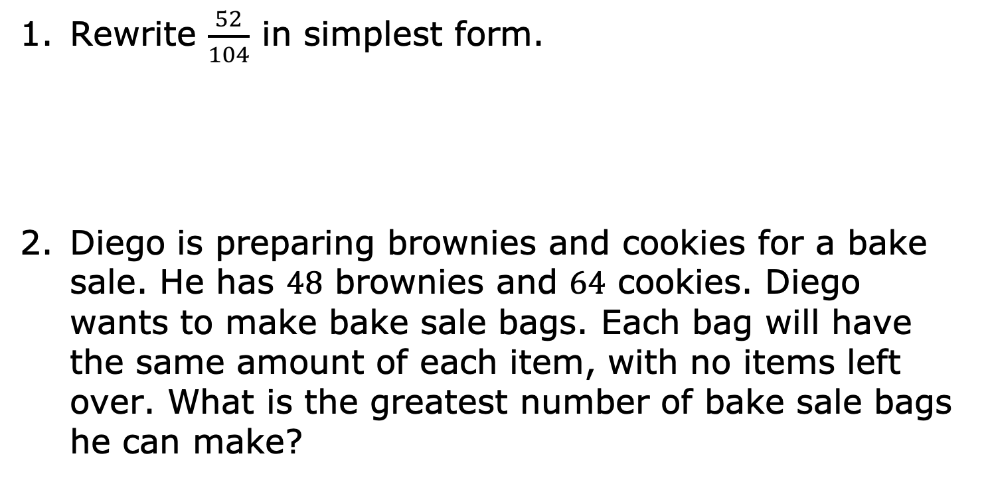
1.1.7 Wrap-Up: Ticket Out the Door
Rewrite $\frac{52}{104}$ in simplest form.
Diego is preparing brownies and cookies for a bake sale. He has 48 brownies and 64 cookies. Diego wants to make bake sale bags. Each bag will have the same amount of each item, with no items left over. What is the greatest number of bake sale bags he can make?
volume 1, pg. 8

